Slide 1
Safety aware design of Robotic Systems
Munich, 17.09.2019

Slide 2
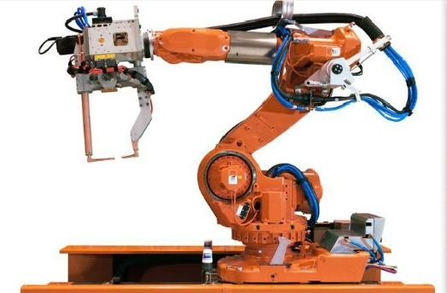

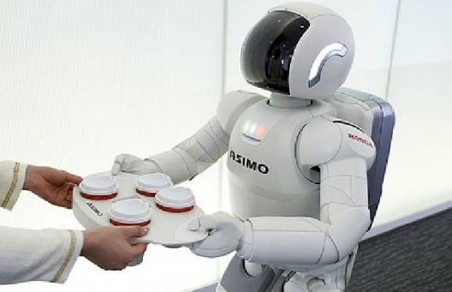
Safety as an Key Factor in Robotics Innovation
Safety of robotics applications must be guaranteed
Legal directives and standards compliance must be fulfilled!

Slide 3
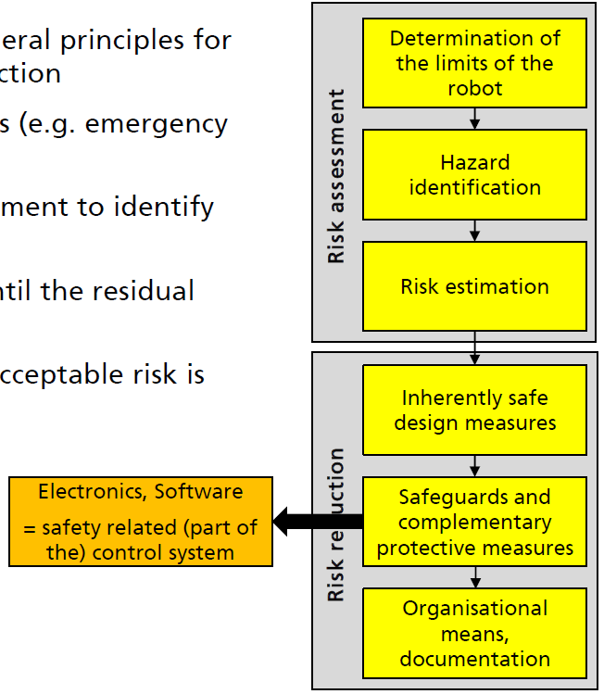

Safety Standards in Robotics
ISO 12100 – Safety of machinery – General principles for design – Risk assessment and reduction
ISO 10218-1/2 - Robots and robotic devices - Safety requirements for industrial robots
  Part 1: Robots requirements for the design of manipulators for industrial environments
  Part 2: Robot systems and integration
ISO/TS 15066 – Robots and robotic devices – Collaborative robots
ISO-DIS 13482 – Safety of Personal Care Robots
IEC 61508-3 – Functional safety of electrical/electronic/programmable
safety-related systems
ISO 13849-1 – Safety of machinery – Safety related parts of control systems –
Part 1: General principles for design
(Industrial) Robots
Functional Safety
IEC 62061 – Safety of machinery Functional safety of safety-related electrical/electronic/programmable control systems

Slide 4
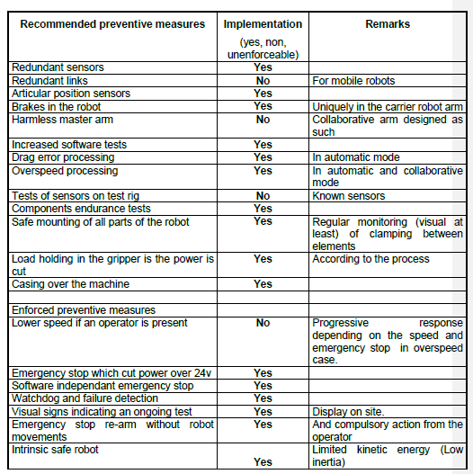
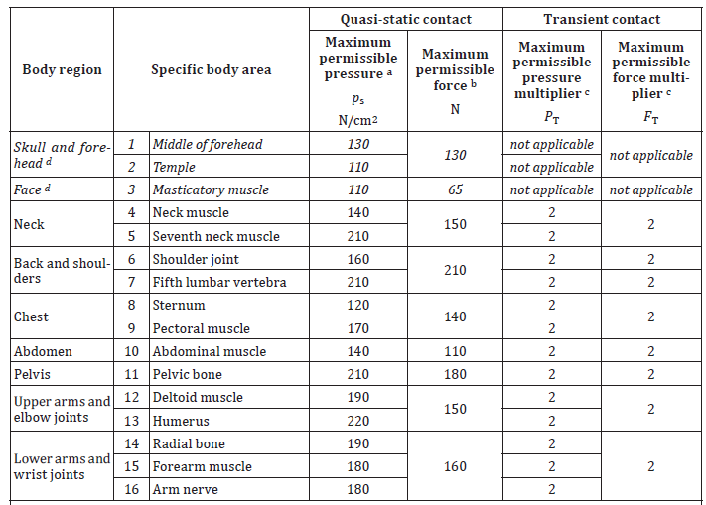
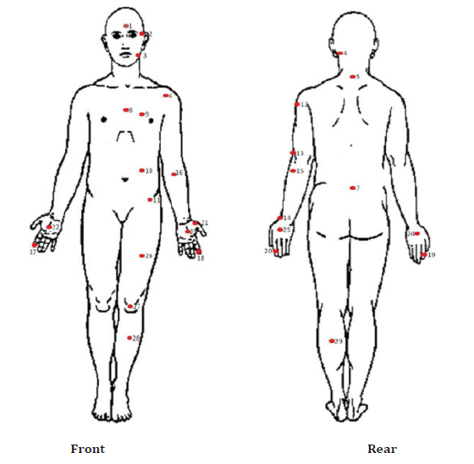
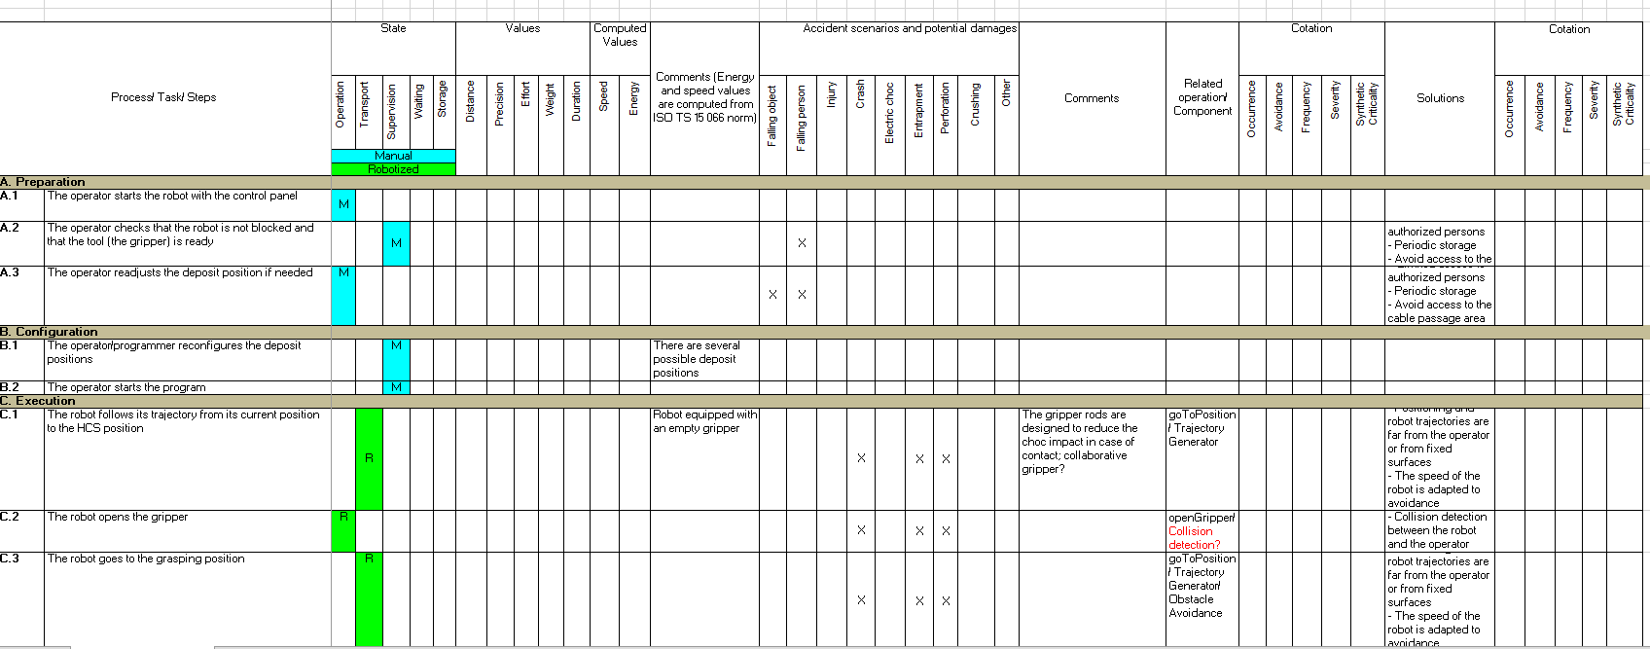
Safety Standards in Robotics
Robotic Guidelines (previous slide)

Slide 5
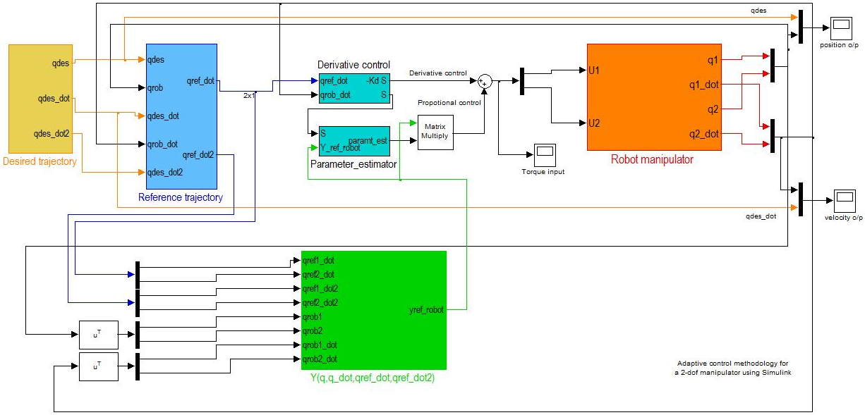
Why Models for Safety Assurance?
If a fault develops here
What effect does the fault have?
On the outputs
System Design Model
Credits: Yiannis Papadopoulos, University of Hull, U.K

Slide 6
Papyrus 4 Robotics:
Modular & role-based design
Safety Assurance at different levels
Compositional safety analysis
Fault Injection
Dynamic task execution & monitoring
Notes:
RobMoSys follows a model-driven approach to standardise those concepts.
We have defined composition structures organised in semantically related concepts, which provides a common and harmonized way to perform multiple development activities, such as architectural design, validation and verification, code generation and deployment.
RobMoSys enables separation of concerns as a mechanism to distribute the complexity of the development problem and to collaborate in a consistent way.

Slide 7
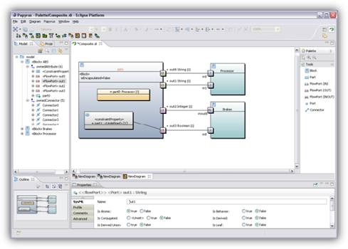

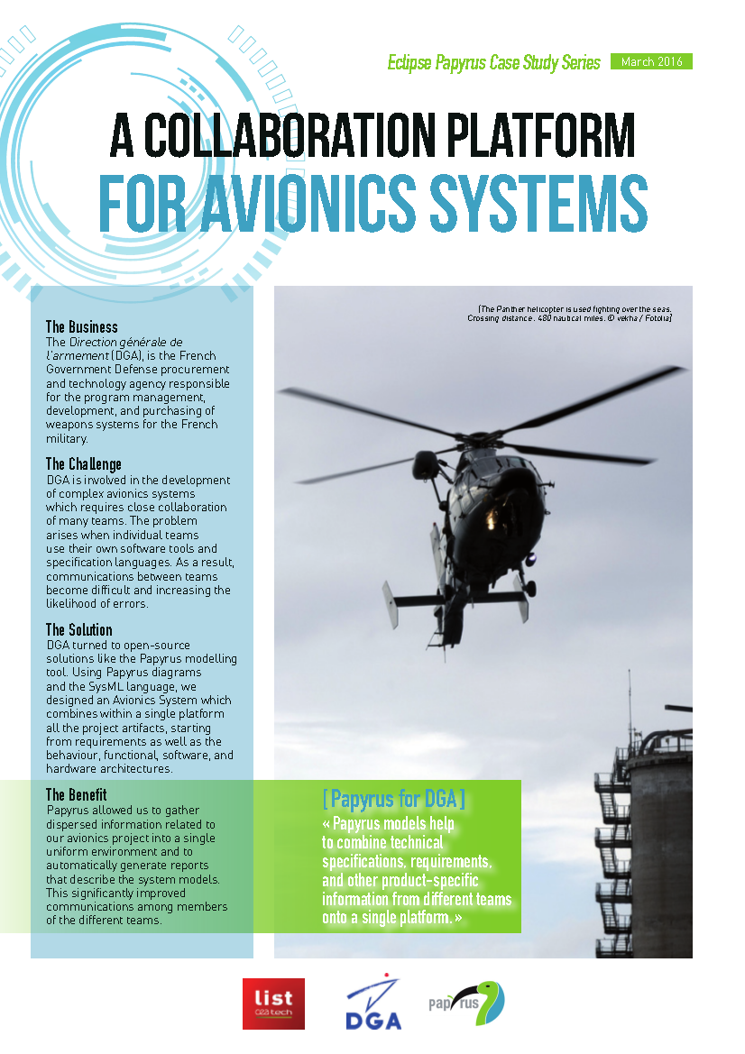
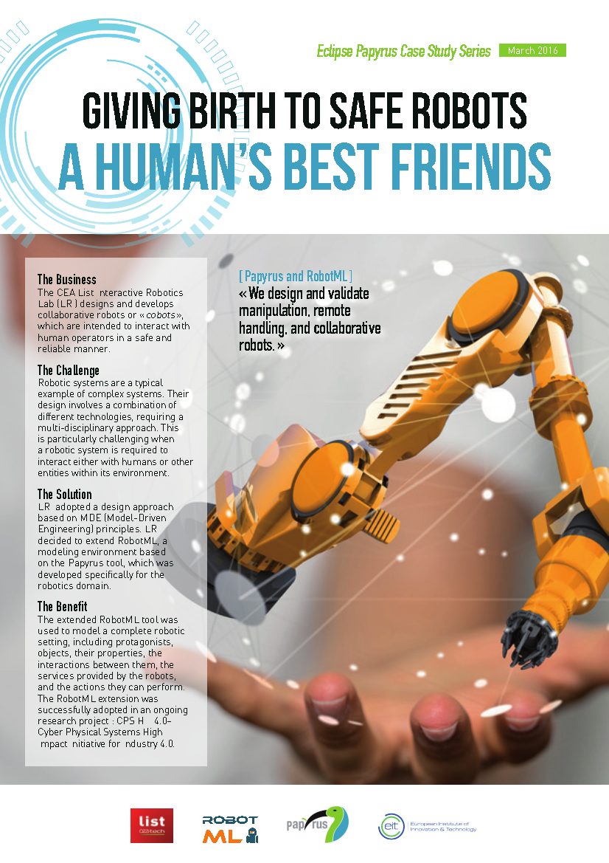
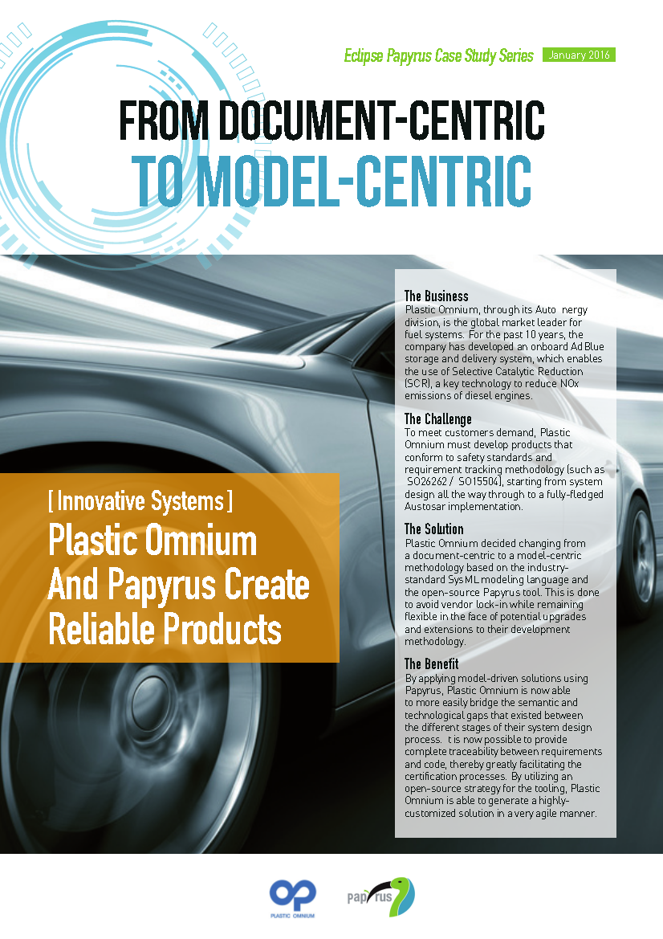
Papyrus(4Robotics)
Papyrus
  One-liners
    Industrial-grade open source Model-Based Engineering tool
    Standard based (UML, fUML, SysML, MARTE, FMI 2.0, …)
    Customizable to address domain-specific concerns (model explorer, diagram notation and style, properties views, palette,…)
  Get started: https://www.eclipse.org/papyrus/documentation.html
  More on successful use-case stories: https://www.eclipse.org/papyrus/testimonials.html
  Papyrus Industry Consortium:
  https://www.polarsys.org/papyrus-ic/about
Papyrus4Robotics – customization of Papyrus for the robotics domain
  RobMoSys-aligned modeling front-end and tools for code generation and
  assessment of multiple design criteria (functional V&V, safety, performance, …)
  https://robmosys.eu/wiki/baseline:environment_tools:papyrus4robotics

Slide 8
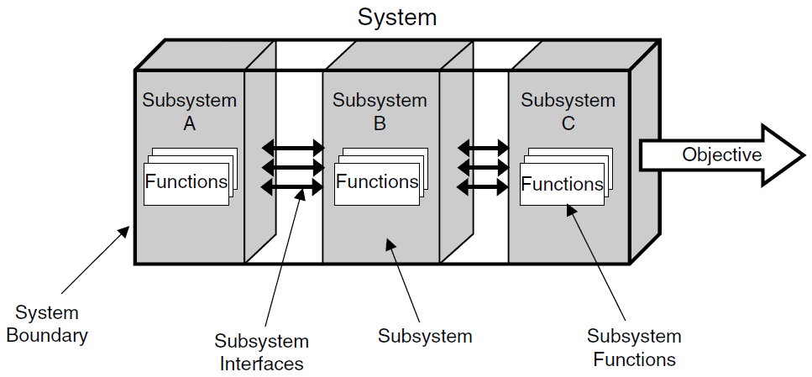
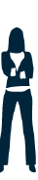
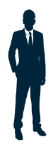
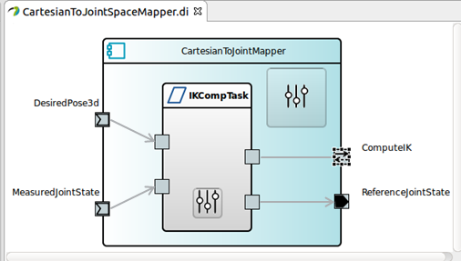
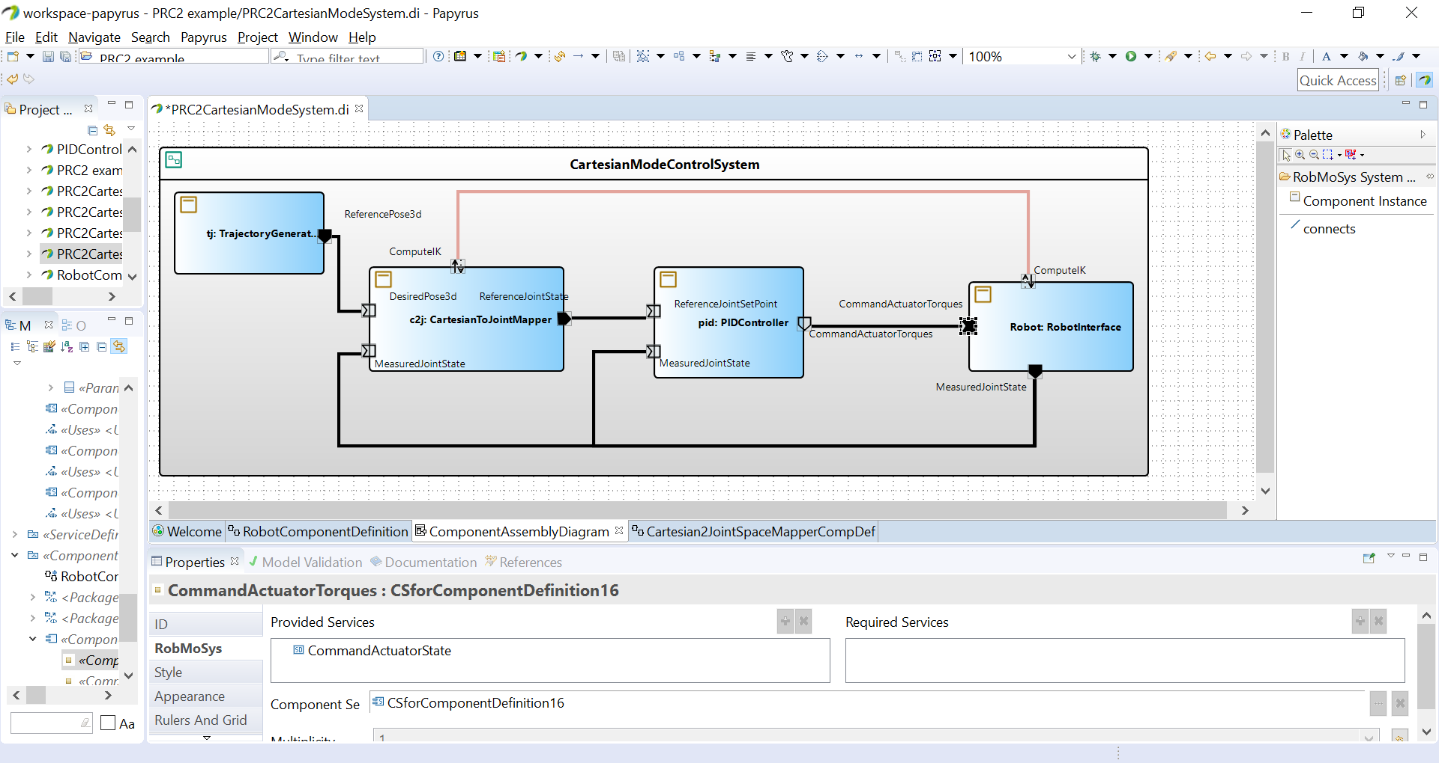
System Models
component
supplier
RobMoSys System Views:
system
builder
Notes:
Différentes vues du système au lieu de la programmation classique

Slide 9
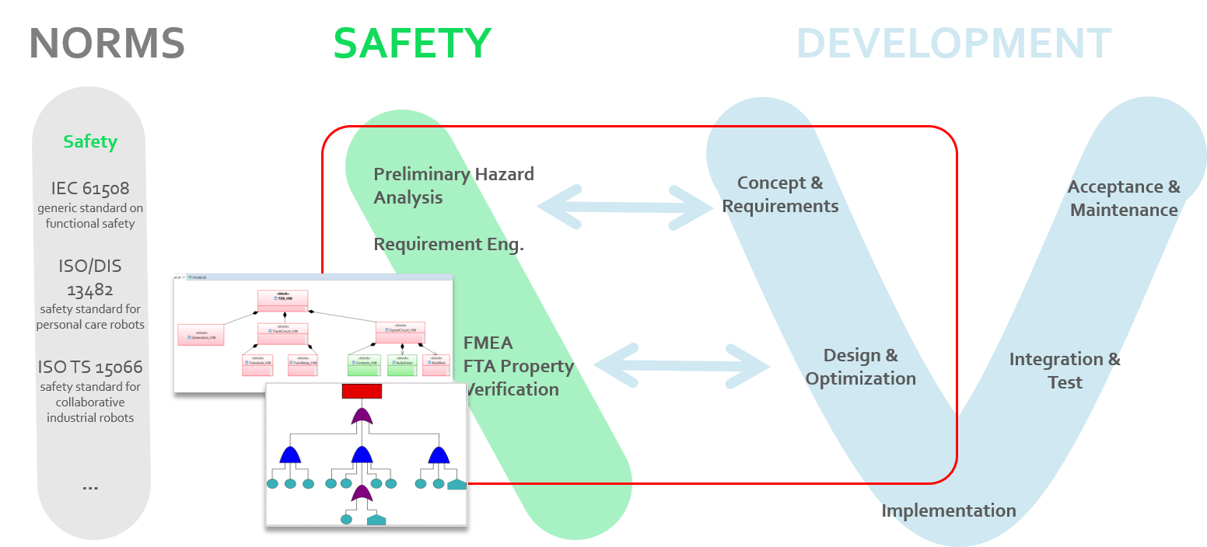
Safety Analysis with Papyrus4Robotics
Rationale
  Conformance to safety standards
  Link architecture descriptions with dedicated safety analysis concepts
Address safety concerns in the early design phases
  (Task based) Hazard Analysis
  Failure Mode & Effect Analysis
  Fault Tree Analysis
  Fault propagation
  (LA)
  Fault Injection
Notes:
Hazard Analysis
Elicitation of severity of hazards impact guided by standards (PHA, SHA, FHA)
Failure Mode & Effect Analysis
Framework and engines for analysis of causes and effects of component failures (FMEA
Generation of FMEA reports in the form of tables, documentation, and friendly-readable formats
Fault Trees Analysis
Generation of Fault Trees by propagation of failure behavior (FTA), and qualitative or quantitative evaluation (probabilistic, sensitive)
Property Verification
Formal verification of safety CTL/LTL properties
Safety Guidelines
ISO-DIS 13482: Safety of Personal Care Robots

Slide 10
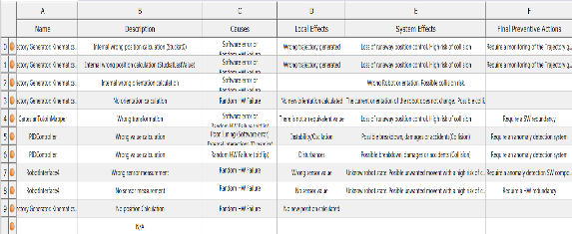

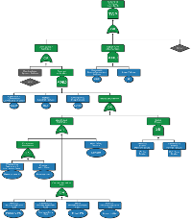
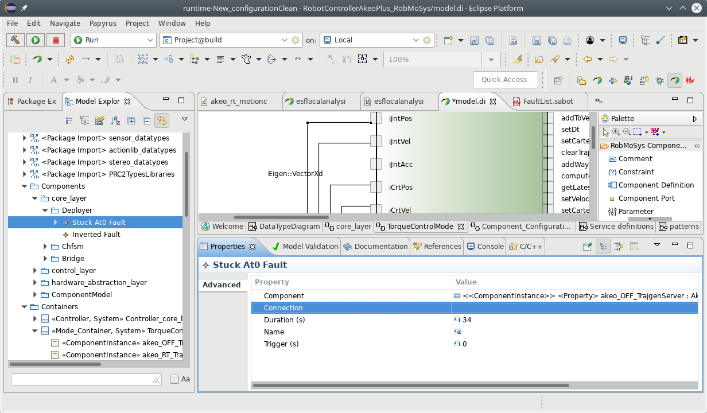
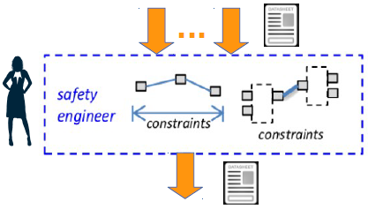
Fault Analysis with RobMoSys
component
supplier
Component Definition View
Failure Modes & Analysis (FMEA) view
system
builder
critical path
System Design View
Fault Tree Analysis (FTA) view
safety
engineer
Component Safety View
Safety
Engineer
Fault Injection (FI) view

Slide 11
Look at an example
Cartesian impedance controller
(industrial robotic arm)

Slide 12
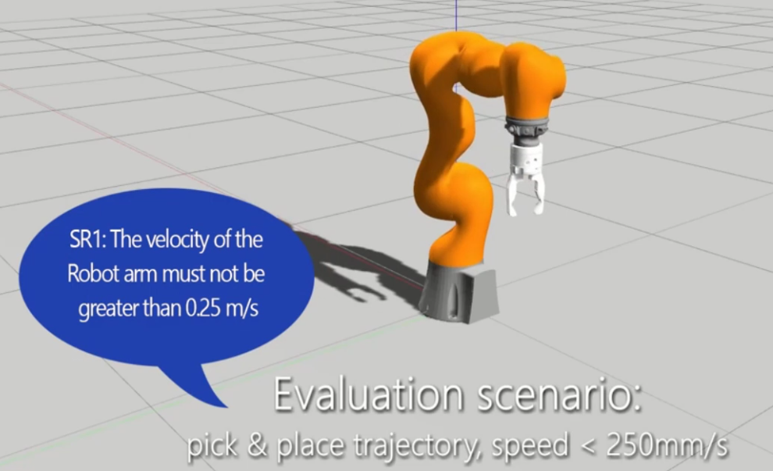
Safety Analysis Use Case Scenario
Design of a real-time Cartesian impedance controller, in torque mode.
Identify and monitor critical faults to avoid unintended movements (hazard), that may cause collisions (harm).
“pick & place trajectory speed < 250 mm/s”

Slide 13
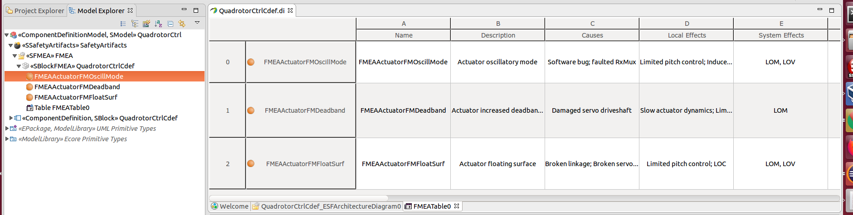
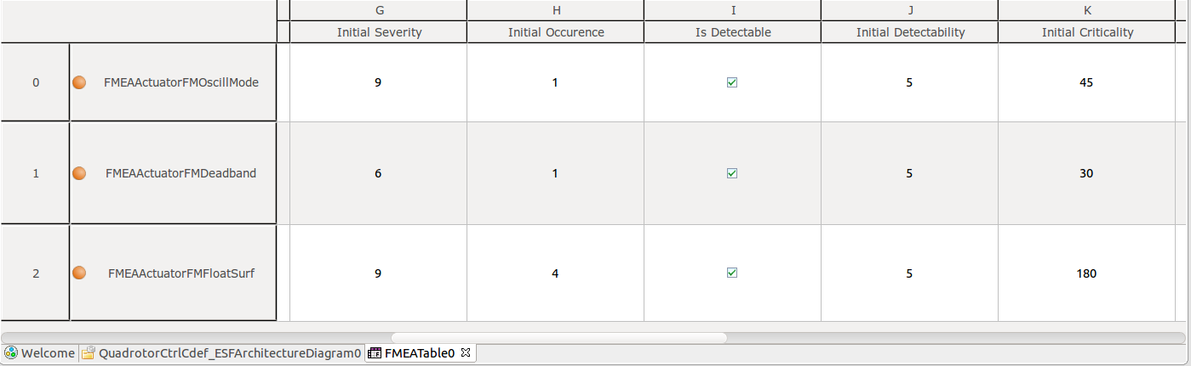
Model-based Safety Analysis (FMEA)
FMEA Analysis context, FMEA table and failure modes
→ effects and their criticality (automatically computed)
…
…

Slide 14
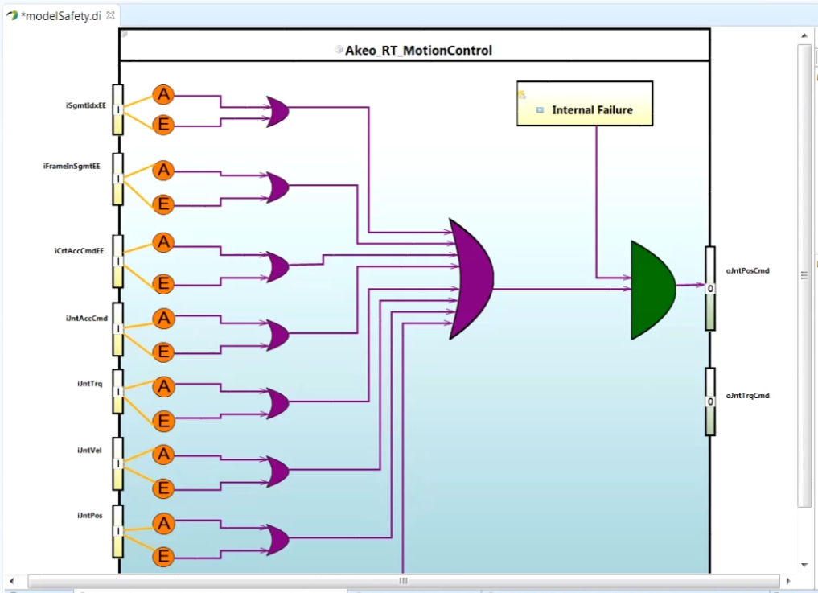
Model-based Safety Analysis (LA)
Local Analysis (LA): link failures modes of stream output with failure modes of input stream (or internal failures)

Slide 15
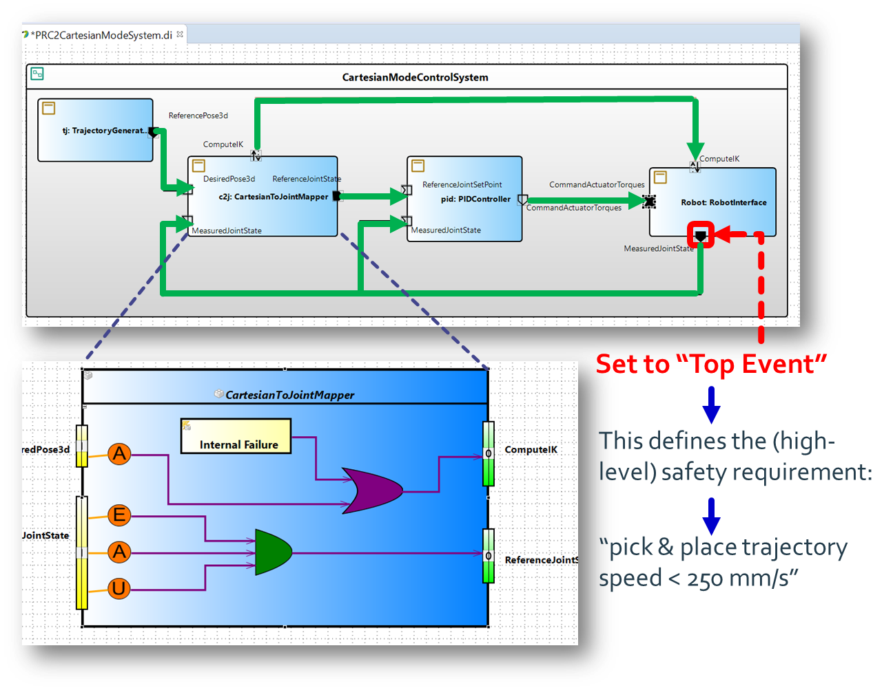
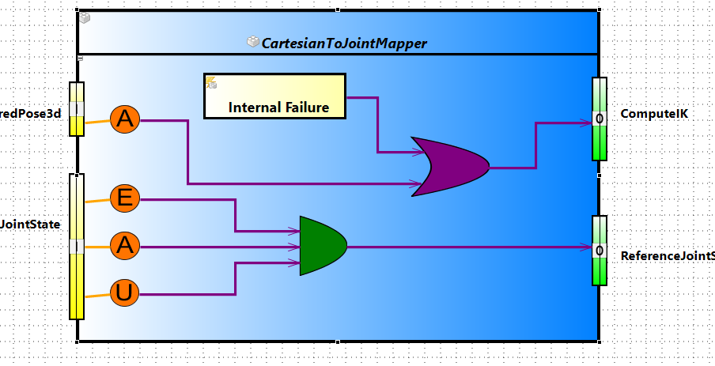
Fault Tree Analysis
Faults that must be monitored and mitigated

Slide 16

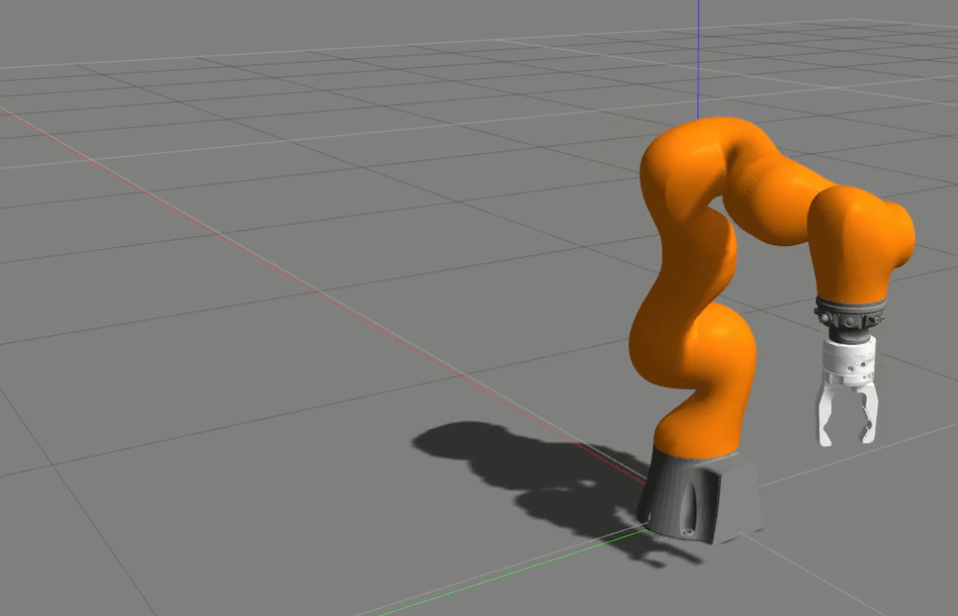

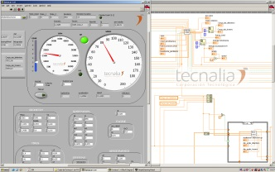
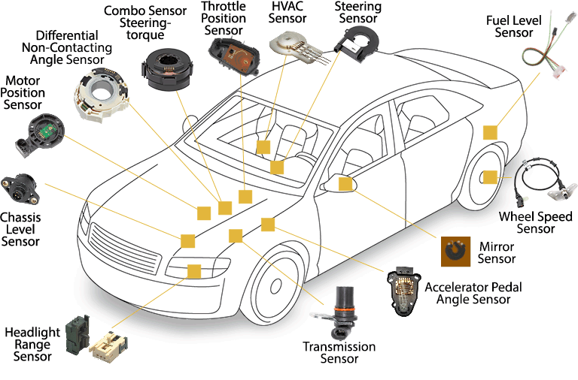
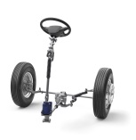
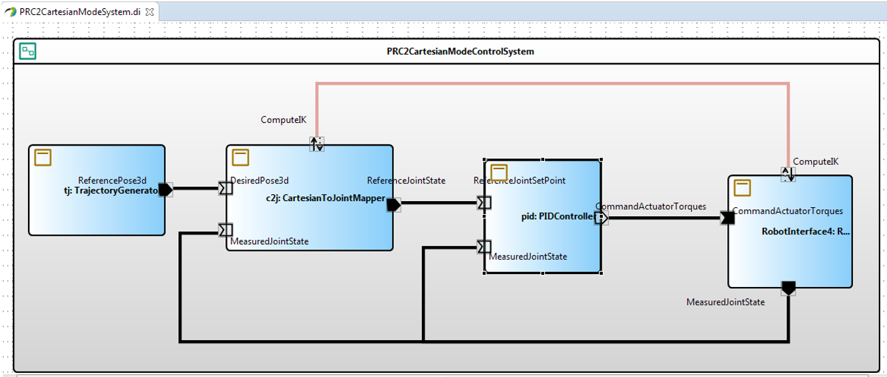

Framework
safety
engineer
Fault Injection View
Workload Generator
System Model Selection
Step I: Set Up
Step II: Robotics Scenario Configurator
Operational Situation
Selection
Robot
Selection
Library of Robots,
Operational Scenarios
3D Environment
Step III: FI Experiments Configurator
Fault List
Generation
Refine the system model until reaching the required level of safety
Fault List
Step IV: Fault injector
(1 to n)
Robotics Dynamics
Model
Library for Sensor and Actuator Models
Fault Library
Fault Injection
Faulty
Generated Code
Step V: Controller/Monitor
Run Golden
Golden Results
Data Analysis
Run n Faulty
Faulty Results
Notes:
The eITUS framework sets up, configures, executes and analyses the simulation results. Model-based design combined with a simulation-based fault injection technique and a virtual robot poses as a promising solution for an early safety assessment of robotics systems. The added value of including robots and environment models is that the maximum time before the robot dynamics are unsafely affected can be identified. In other words, it allows quantitatively estimating the relationship of an individual failure to the degree of misbehaviour on robot level.

Slide 17
Compositional Safety Analysis
Cartesian impedance controller
Video

Slide 18
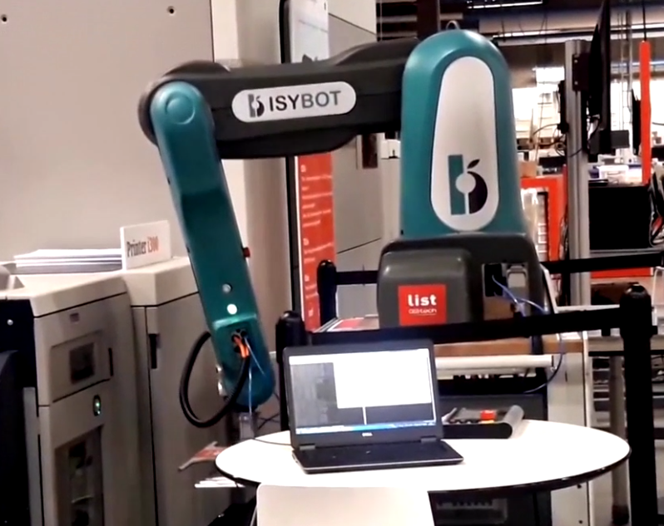
Tasks & skills
Execution and monitoring

Slide 19
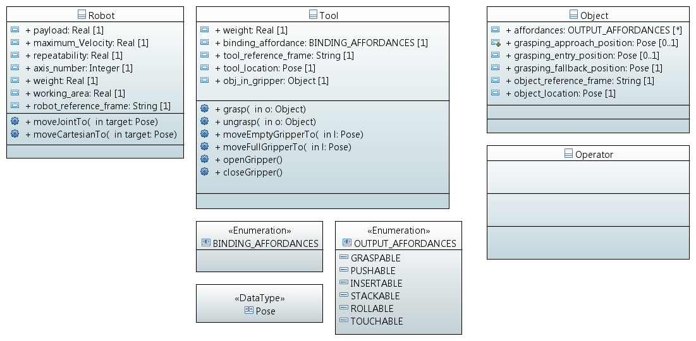


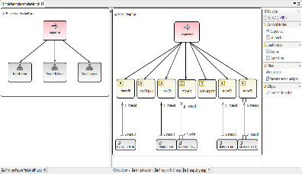



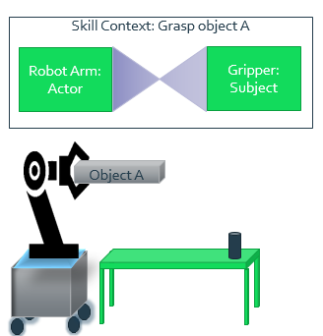

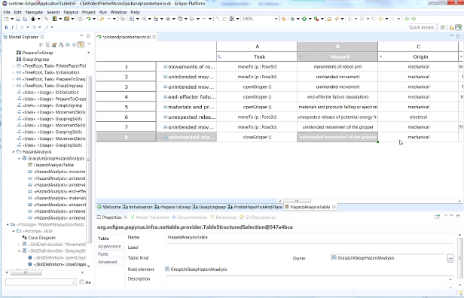
Integrating task & skill models
Constraints Based on actual robot skills, e.g:
Maximum Speed
Maximum Pressure
Maximum weight
Guidance for risk analysis
Knowledge about the preconditions/effects
Rules/
Constraints/
Knowledge
Skills Model
Knowledge about the
robot behavior
Task Model
Knowledge about the
affordances/rules/
constraints/Protagonists
(objects/humans/robots)
World Model
Safety
Guidelines
Safety Expert
Risk Assessment

Slide 20
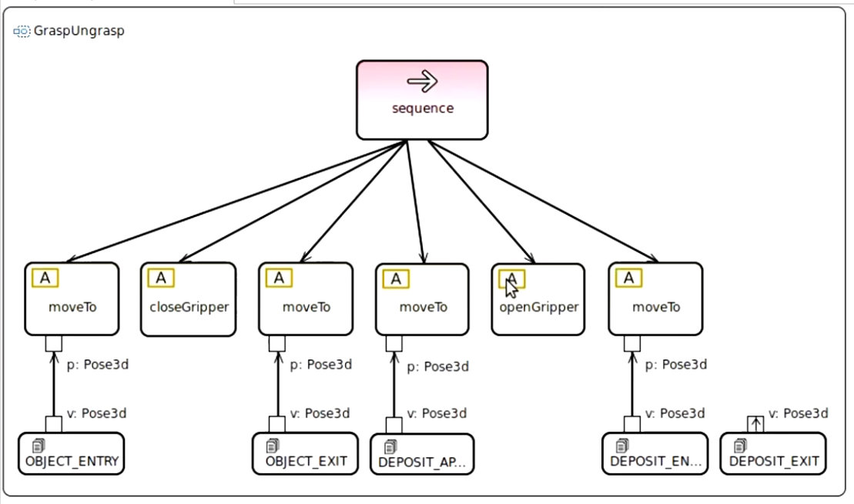
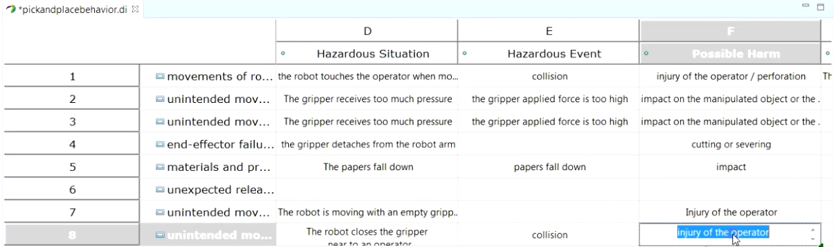
Execution and monitoring
Use behavior trees to specify and execute behavior
Identify and monitor task based risks

Slide 21
Gripper Example
Video

Slide 22

Context-Aware Robustness
At Design time
At runtime
World Monitor
Skills Model
Task Model
Data Sheet
Data Sheet
Data Sheet
World Model
Robot
Object
Human Operator

Slide 23

Recap
Papyrus4Robotics
  “umbrella framework that collects a set of Papyrus-based DSLs and tools and supports the design of robotic systems in conformance with the RobMoSys approach”
Support
  Fundamental roles such as component developer, service designer, system builder, etc.
  Model-Based safety analysis (FMEA, LA, FTA)
  Integration between roles/views
  ROS2 Code generation, ROSIN FTP
Next version
  new release coming soon (End of September ´19)

Slide 24
Thanks!
Questions?

